Slide 1
C# 6.0
Feb 2017

Slide 2
New in C# 6.0

Slide 3
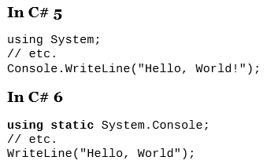
Static using

Slide 4
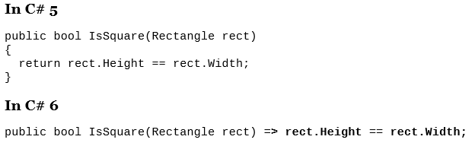
Expression-bodies methods

Slide 5
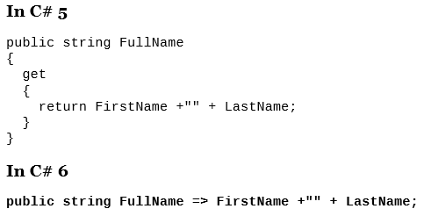
Expression-bodies properties

Slide 6
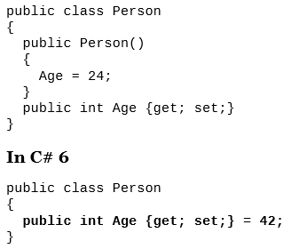
Auto-implemented property initializers

Slide 7
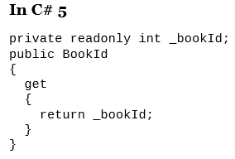

Read-only properties

Slide 8
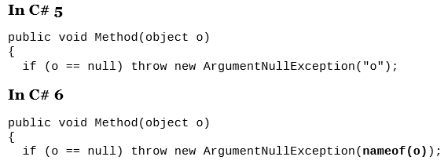
nameof Operator
Name changes are not missed with refactoring

Slide 9
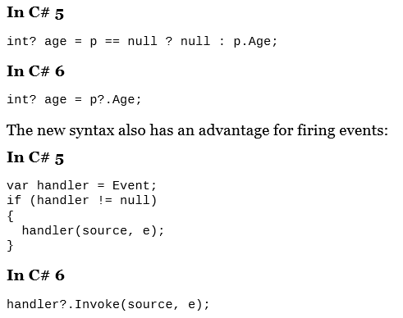
Null propagation operator

Slide 10
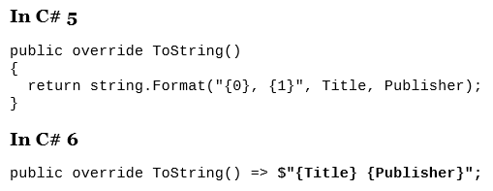
String interpolation

Slide 11
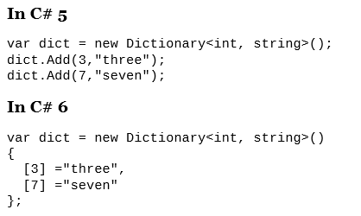
Dictionary initializers

Slide 12
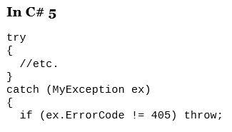
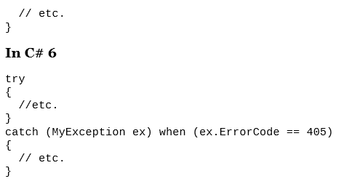
Exception filters

Slide 13
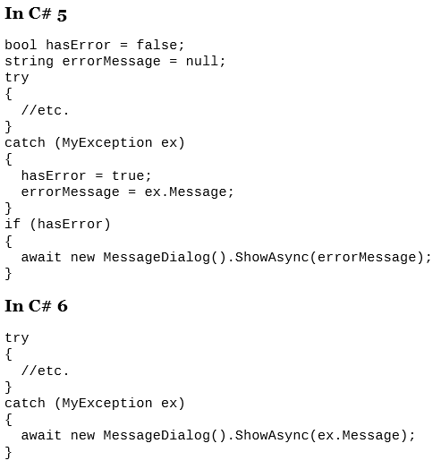
await in catch

Slide 14
.Net Application Architectures

Slide 15
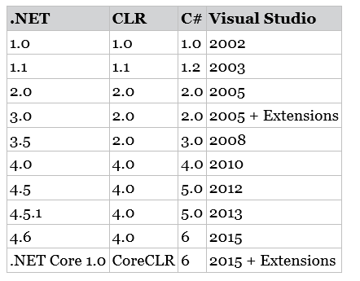
History
Generics
LINQ
Dynamic & TPL
Asynchronous

Slide 16
History Which tech to choose?
Asp.Net Web Forms vs Asp.Net MVC
Windows Forms vs WPF
LINQ to SQL vs Entity Framework
List<T> vs ArrayList

Slide 17
Choice for going forward
Windows app: WPF / UWP > Windows Forms
Web: Asp.Net Core + MVC 6 > Web Forms
DB: Entity Framework > LINQ to SQL
Managed Extensible Framework > System.Addin

Slide 18
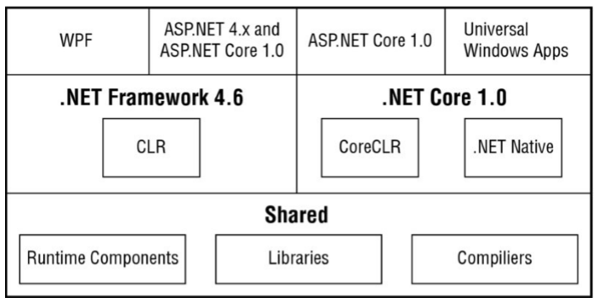
.Net 2015

Slide 19
Basic namespace - .Net 4.6
Namespace | Description
System.Collections | Collections
System.Data | Database acess
System.Diagnostics | Logging & Tracing
System.Globalization | Globalization & Localization
System.IO | Files & Directories
System.Net | Core networking
System.Threading | Thread & Tasks
System.Web | Asp.Net
System.Windows | WPF

Slide 20
.Net Core 1.0
Open source, http://www.github.com/dotnet
Runtime is delivered with the application
Unlike .Net framework, specific version must be installed
Modular approach
Lot of NuGet packages

Slide 21
Features of .Net Core
Open source
Based smaller NuGet packages
Support Multiple platforms
Can compile to native code
Existing apps can still evolve

Slide 22
Assembly
exe & dll files
Contains metadata, self describing

Slide 23
NuGet packages
Zip file contains
Assembly
Configuration
PowerShell scripts
Accessed from
http://www.nuget.org
Can be searched inside Visual Studio

Slide 24
Common Language Runtime
.Net Framework 4.6 use CLR
.Net Core use CoreCLR
What does it do?

Slide 25
Two steps compilation
Step 1: Source code to Intermediate language (IL)
Step 2: IL to platform-specific native code
Happen during runtime with JIT compiler
JIT = Just in time

Slide 26
.Net native
Compile a managed program to native code
UWP to native code for apps deployed to Store
Also available with other .Net Core applications
Can create apps to run on Linux, too

Slide 27
Hello world

Slide 28
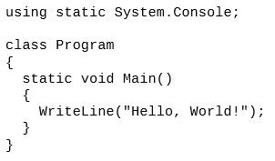
Code & compile
Run this to compile
csc HelloWorld.cs
csc path: C:\Program Files (x86)\MSBuild\14.0\Bin
From Roslyn, compiler no longer in MS .Net Framework

Slide 29
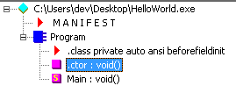
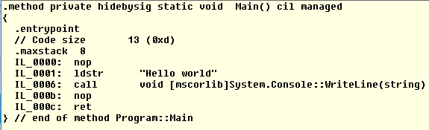
IL DASM
Path: C:\Program Files (x86)\Microsoft SDKs\Windows\v10.0A\bin\NETFX 4.6.1 Tools

